Slide 1

Employee Retention Project
PROJECT BOOTCAMP

Slide 2

Project Mentor:
Pushpraj Rathore

Slide 3

Project Members:
Ms. Anjali A. Patil
Ms. Shivani R. Gavali
Mr. Manish H. Parihar
Mr. Vishal Bavaliya

Slide 4

Introduction:
Within the realm of HR Analytics, the Employee Retention project centers around obtaining valuable insights into workforce dynamics and strategies for retaining employees. By utilizing two Excel datasets, HR_1 and HR_2, the project focuses on analyzing employee data to uncover significant patterns and correlations. With each dataset containing 50,000 records, HR_1 and HR_2 serve as extensive repositories of information that are essential for comprehending the factors that influence attrition, employee engagement, and overall workplace dynamics. The Excel data format enables a thorough exploratory analysis, facilitating a detailed examination of various HR metrics. Through this project, the objective is to uncover crucial insights that can guide strategic decision-making and improve employee retention strategies within the organizational landscape.

Slide 5

KPI’s (Key Performance Indicator):
Average Attrition rate for all Departments.
Average Hourly rate for Male Research Scientist.
Attrition Rate Vs Monthly Income Stats.
Average working years for each department.
Job Role Vs Work Life balance.
Attrition rate Vs Year since last promotion relation.

Slide 6
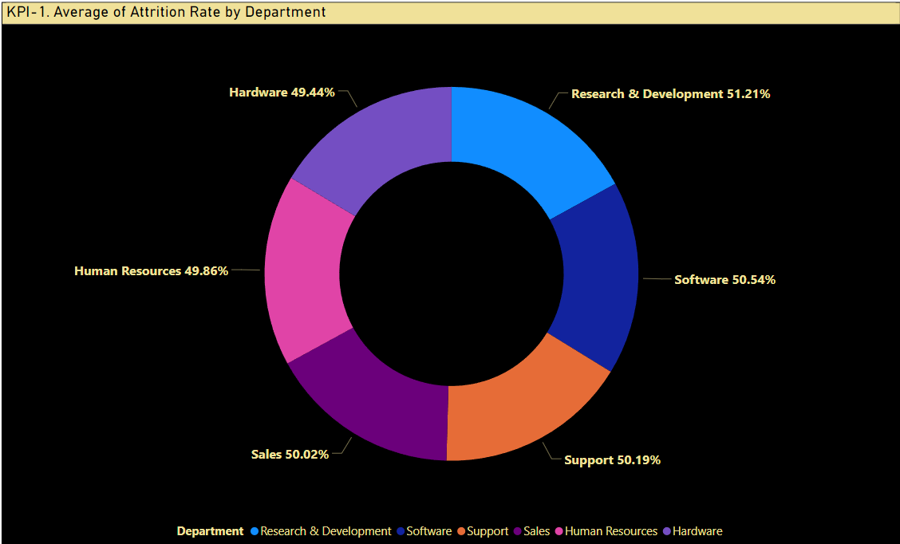
1st KPI: Average Rate for all Department
This KPI, visualized through power BI, provides a comprehensive overview of attrition rates across all departments. Stakeholders can easily compare and identify patterns, enabling effective workforce management strategies and targeted interventions in departments with higher attrition.
From this calculation and visualization we concluded that we must make strong strategies to minimize attrition rate and improve our company’s employee retention so that we can balance the company’s growth and right talent.

Slide 7
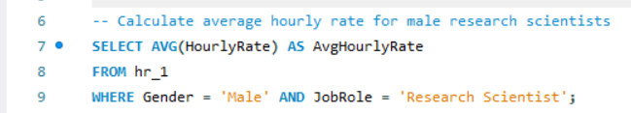
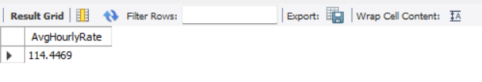
2nd KPI: Average Hourly Rate for Male Research Scientists
Utilizing SQL for this KPI allows for precise calculation and presentation of the average hourly rate for male research scientists. This insight is crucial for assessing gender-based compensation and ensuring equitable pay practices within the organization.

Slide 8
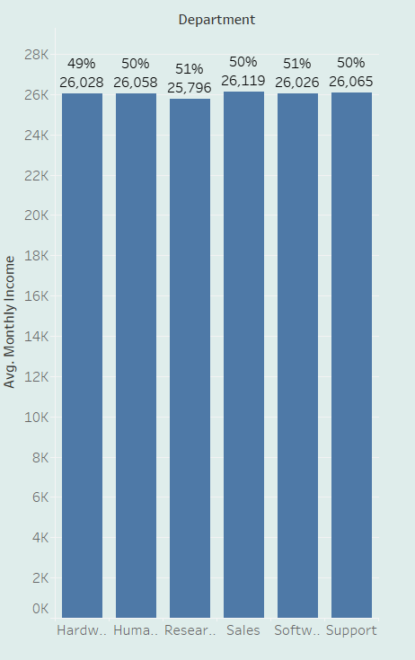
3rd KPI : Attrition Rate Vs Monthly Income
Tableau is employed to create an insightful visualization that compares attrition rates with monthly income statistics. This KPI allows to explore the relationship between income levels and attrition.
In conclusion, while monthly income is a significant factor in attrition rates, a comprehensive understanding of the broader context, coupled with strategic initiatives to address various aspects of employee satisfaction and well-being, is essential for effective talent retention. A balanced and proactive approach will contribute to building a resilient and engaged workforce, ultimately driving organizational success.

Slide 9
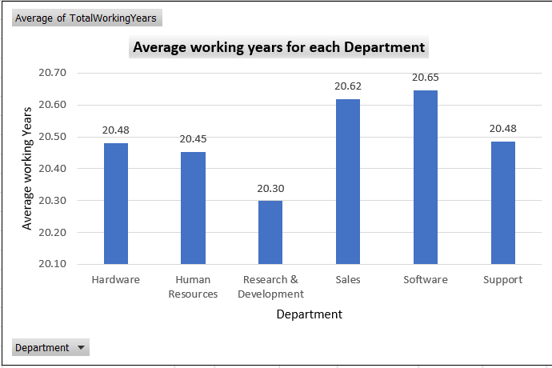
4th KPI: Average Working Years for Each Department
Excel is used to calculate and present the average working years for each department.
In conclusion, analyzing the average working years for each department is a valuable key performance indicator (KPI) that offers insights into the stability and experience level of an organization's workforce. This metric can be indicative of employee satisfaction, career growth opportunities, and the overall health of the organizational culture.

Slide 10
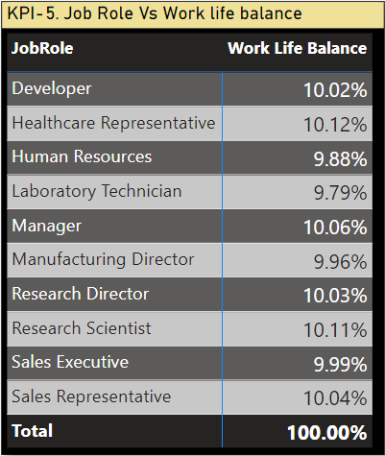
5th KPI: Job Role Vs Work-Life Balance
Power BI is employed to analyze the correlation between job roles and work-life balance. This KPI allows stakeholders to understand how different roles impact employees' perceptions of work-life balance, guiding organizational policies to enhance employee satisfaction and well-being.
In conclusion, analyzing the relationship between job roles and work-life balance is crucial for understanding and optimizing the well-being of the workforce. The Job Role vs. Work-Life Balance key performance indicator (KPI) provides valuable insights into whether employees are able to maintain a healthy equilibrium between their professional responsibilities and personal lives.

Slide 11
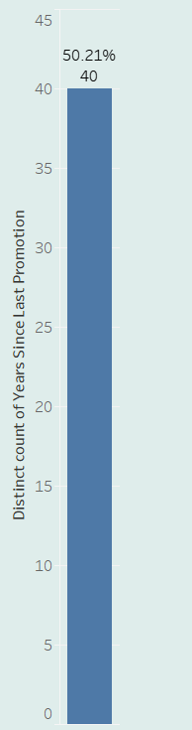
6th KPI : Attrition Rate Vs Years Since Last Promotion Relation
Tableau is chosen for its ability to handle complex relationships. In conclusion, examining the relationship between attrition rate and years since the last promotion is a critical analysis for organizations seeking to understand and manage employee turnover. The Attrition Rate vs. Years Since Last Promotion KPI provides insights into how the timing and frequency of promotions impact employee retention.

Slide 12
DASHBOARDS

Slide 13
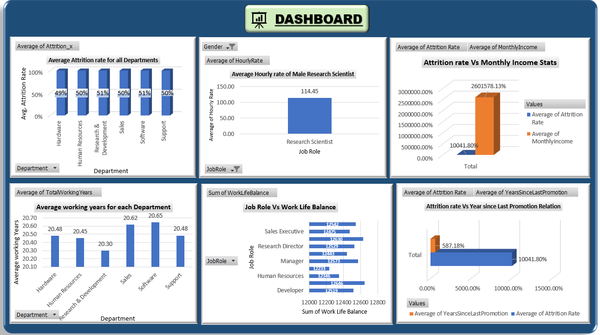
KPIs Performed in Excel :

Slide 14
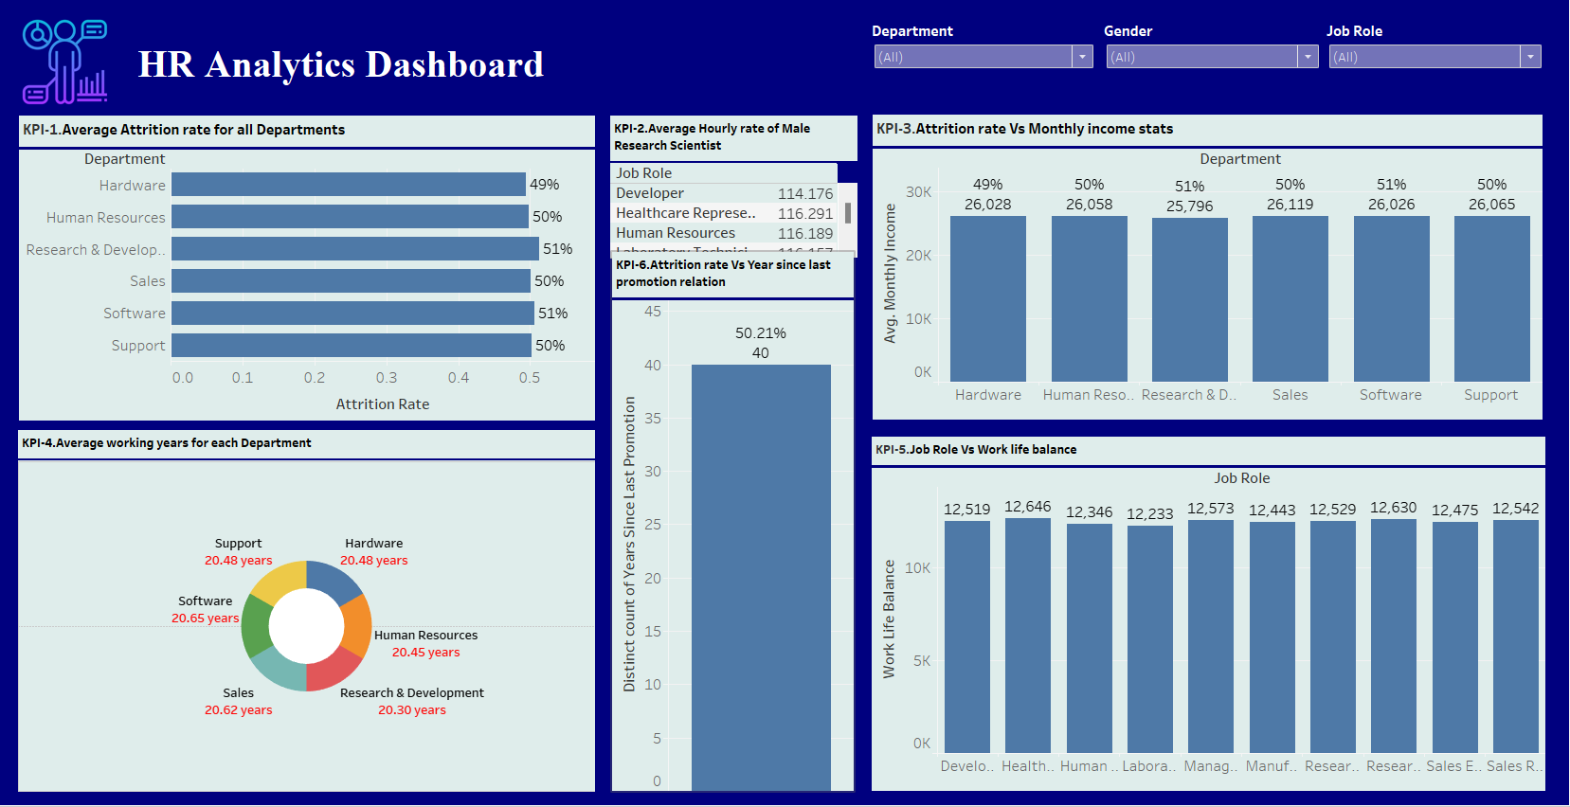
KPIs Performed in Tableau :

Slide 15
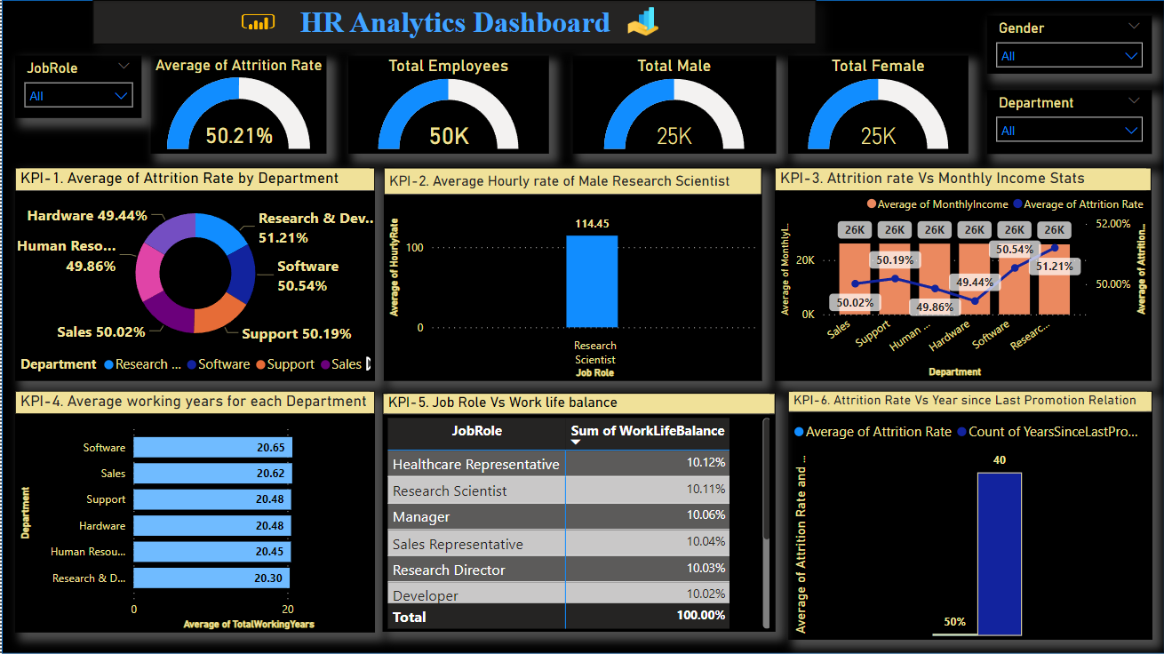
KPIs Performed in Power BI :

Slide 16
Summary :
The employee retention project is a strategic initiative designed to enhance job satisfaction, engagement, and loyalty within an organization. It involves analyzing key performance indicators such as attrition rates, average working years, and the relationship between job roles and work-life balance. The project focuses on implementing measures such as competitive compensation, professional development programs, work-life balance initiatives, and effective leadership development. By addressing these factors, the project aims to create a positive work environment, reduce turnover, and build a committed and high-performing workforce. Regular feedback, data analysis, and adjustments ensure the ongoing success of the employee retention project.

Slide 17
THANK YOU

